Slide 1


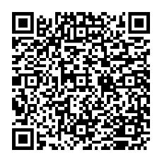
Get help managing your money—for your family, your community & yourself.
Find tools, resources, and events that can help you reach your financial goals.
Learn more
Fidelity Brokerage Services LLC, Member NYSE, SIPC, 900 Salem Street, Smithfield, RI 02917
© 2026 FMR LLC. All rights reserved. 1245682.1.0

